Slide 1
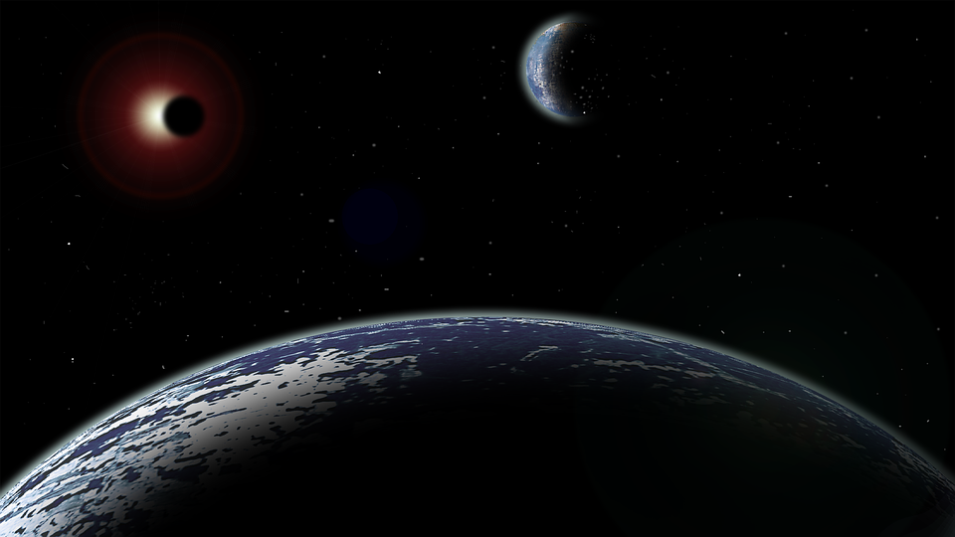

PLANET HUNTERS
A presentation by:
Marc-Alain Adjahi
Jarrett Ames
Harriett Ashford
Adela Bolba
Lucas Tao
Katherine Delevaux
Notes:
Our project is called planet hunters, and we are searching for exoplanets, or planets outside our solar system, names.

Slide 2
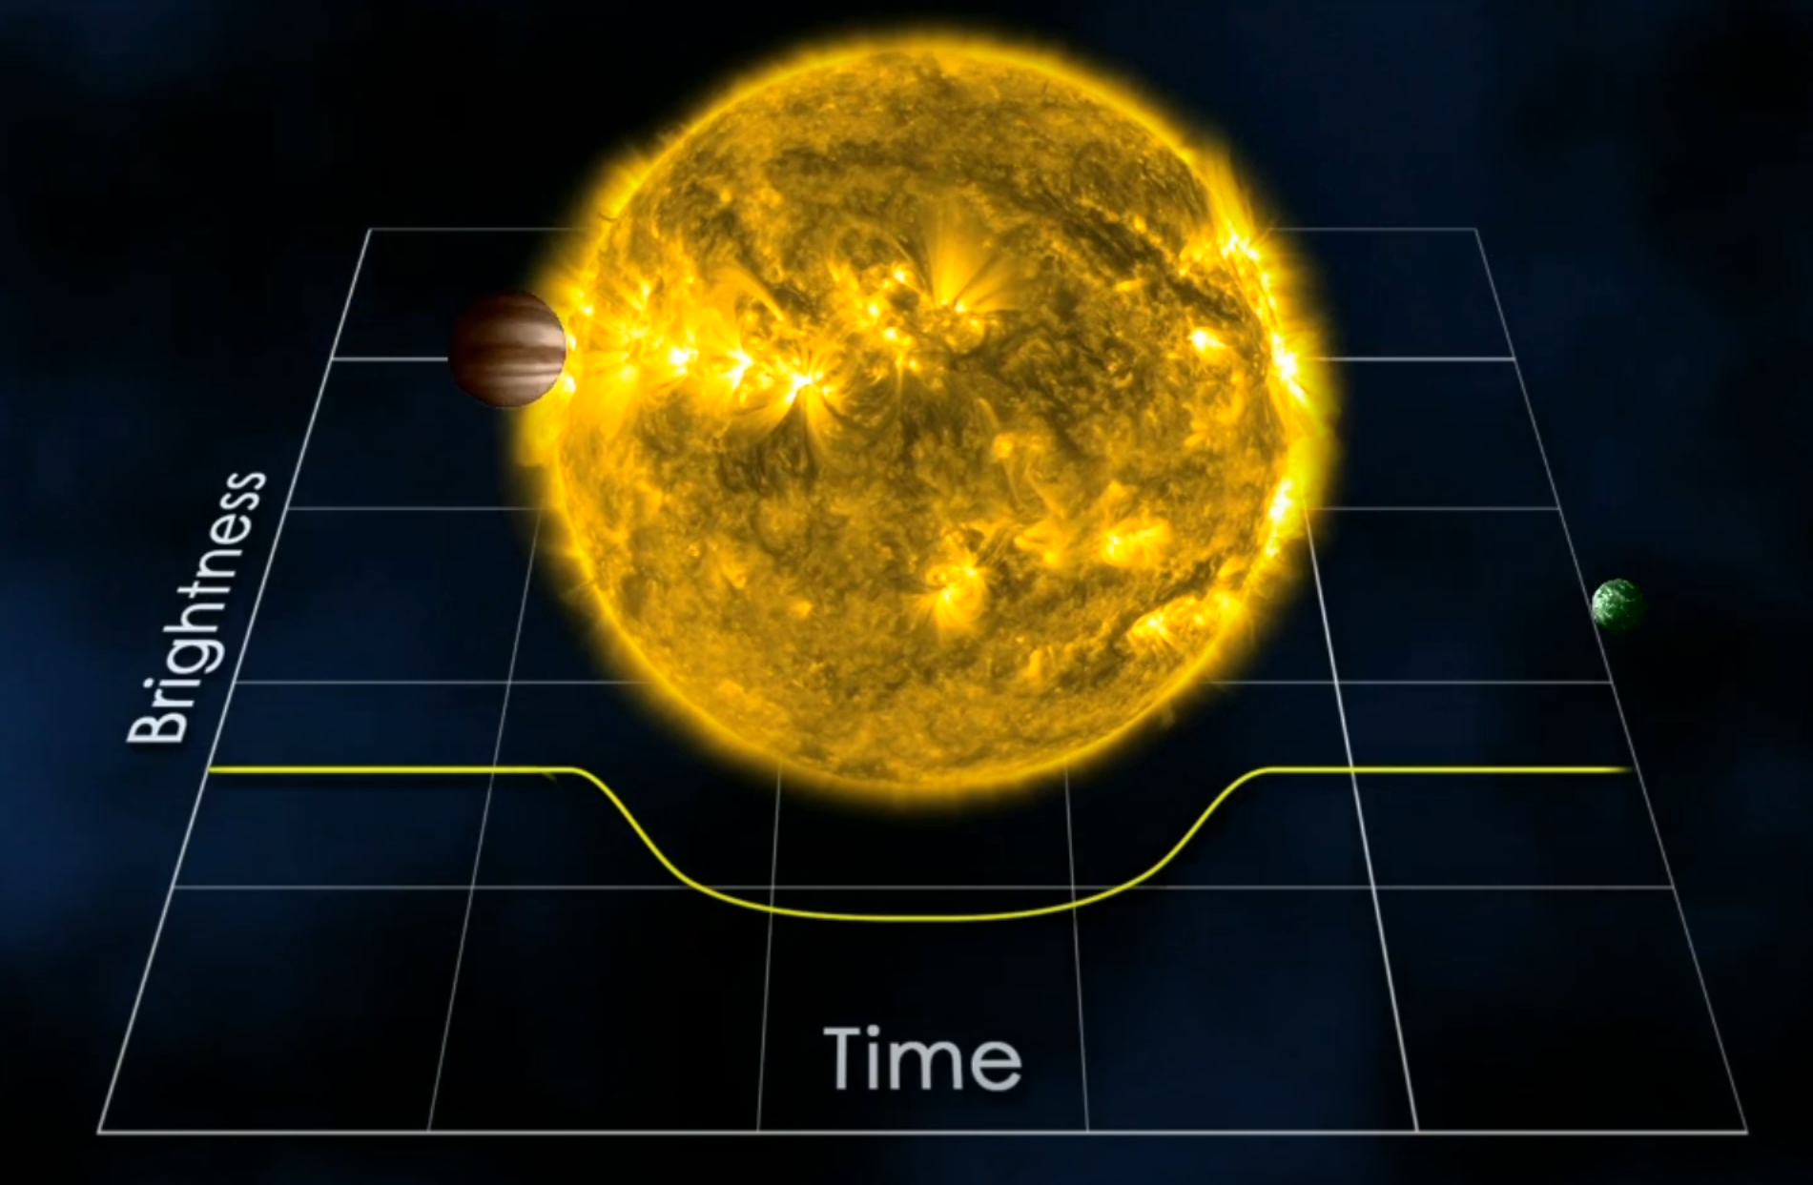
Exoplanets: How do we find them?
Transit Photometry is a method that uses a star’s brightness over time to determine if there is a planet orbiting the star. It must occur at regular intervals and for a fixed length of time for the body to be a candidate.

Slide 3
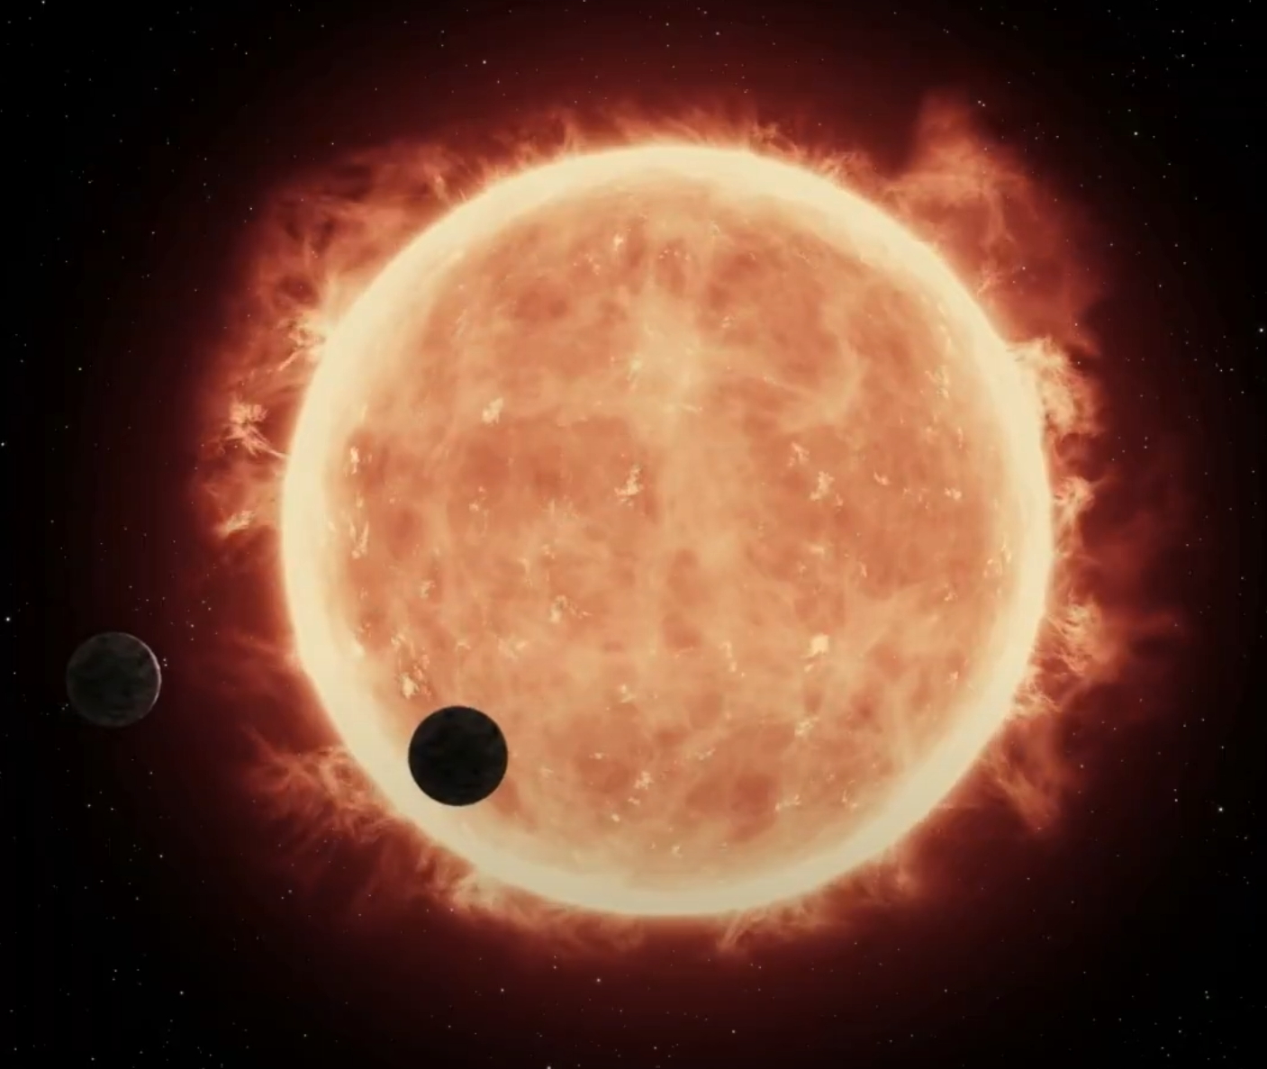
Transit Photometry and Machine Learning
In order for this method to work, the exoplanet has to orbit between the star and Earth. Not only that, but the samples that do contain dips might be false positives due to other bodies and interference. Using Machine Learning, we can sift through the data to find the exoplanets.

Slide 4
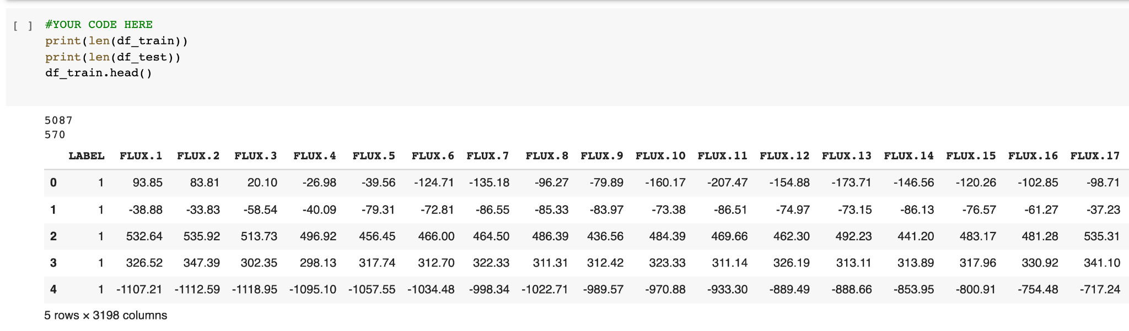
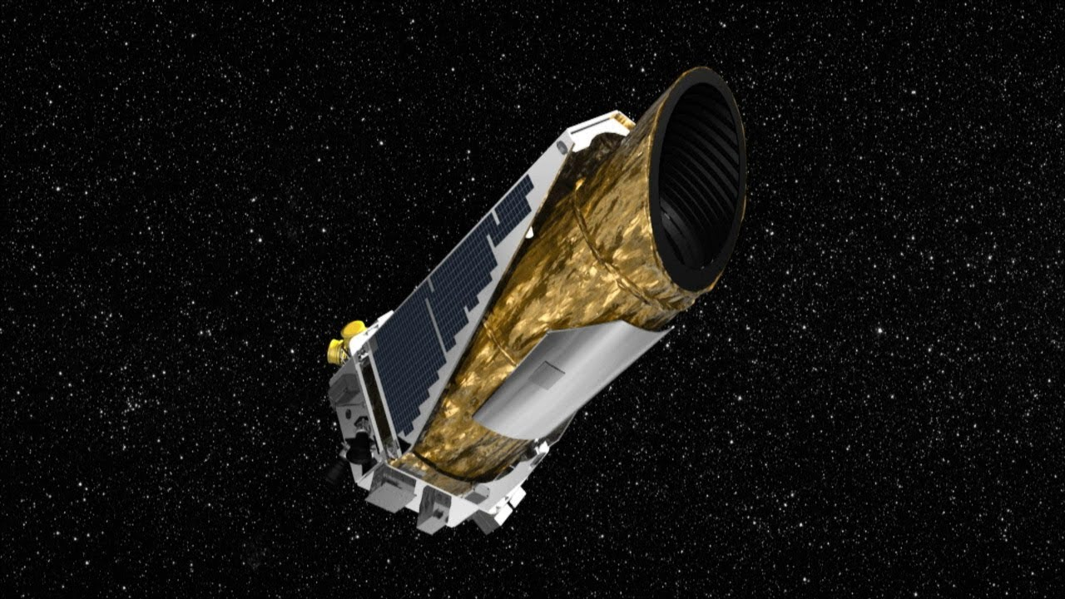
The Data
Where is our data from?
Training Data: 5087 stars
Testing Data: 570 stars
NASA’s Kepler Space Telescope
The flux data represents the intensity of light from the star relative to a base point.
Notes:
Each ‘flux’ point represents the intensity of light from that star when it is taken. There are about 3200 flux points taken in 30 min intervals

Slide 5
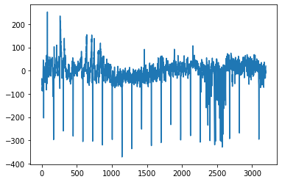
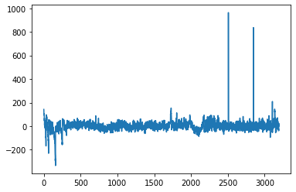
The Data: (Non) Exoplanet ?
Here is an example of a graph showing the flux data over time for an identified exoplanet.
Here is an example of a graph showing the flux data over time for an identified non-exoplanet.
Notes:
Here are to graphs from data collected from two different stars. Write in chat which you guess which represents the data from an exoplanet? The one on the left because as lucas previously mentioned, there are consistent dips of about the same size and separation

Slide 6
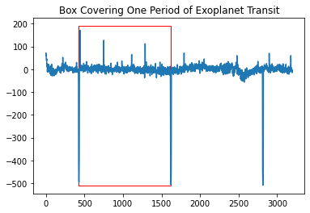
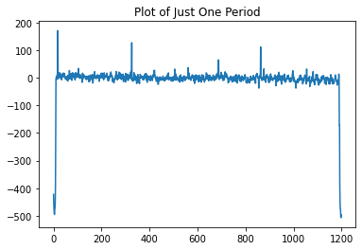
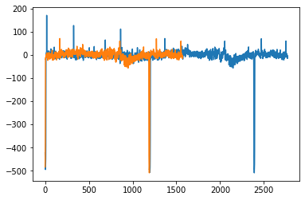
Folding: Checking if we’re actually dealing with an exoplanet
Looking smooth? Let’s see what using a non-exoplanet looks like!
Notes:
First graph isolates a full transit, second graph shows just that one period, and third graph is a superposition of both to check if they match smoothly

Slide 7
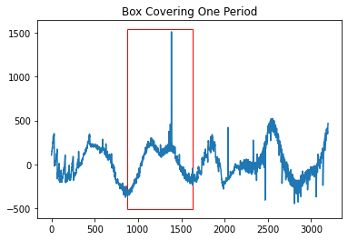
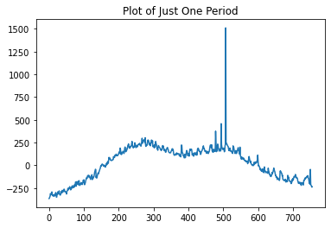
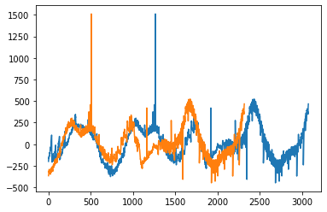
Folding: Non-exoplanet
Doesn’t look as smooth, does it…
Notes:
First graph isolates a full transit, second graph shows just that one period, and third graph is a superposition of both to check if they match smoothly. This one does not match quite smoothly, so we can reasonably assume that it is a non-exoplanet

Slide 8
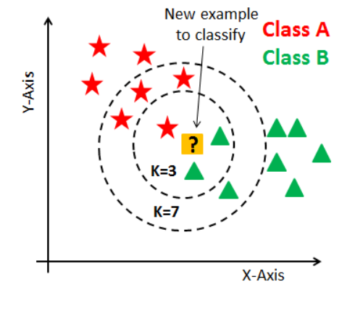
KNN classifiers
The K-Nearest Neighbors Classifier works by using the number ‘k’ nearest known points to the data value to classify a given data point. Generally, odd number values are used for ‘k’ to avoid ties.
Usually the Nearest neighbors function is used for classifying text, photographs of objects, and which type of category raw data points may belong to.
In this image, if k = 3, then the data point will be considered class B, while if k = 7, then the data point will be considered class A.

Slide 9
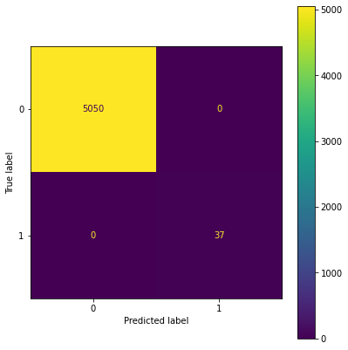
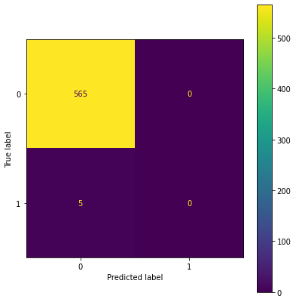
KNN Classifier: Resulting Data
Training Accuracy: 100%
Testing Accuracy: 99.1%
Notes:
Less than 1% of data are exoplanets, hence the ‘not so great’ accuracy of 99.1%

Slide 10

Logistic Regression:
Logistic Regression is an algorithm used in machine learning that predicts the probabilities of a result based on data that was previously “seen” by the model.
It’s commonly used for solving problems involving classifying new data into 2 predetermined categories, also known as “classification problems”.
It works by having the input data go through a series of mathematical operations. It is then compared to the threshold.
Notes:
Add: common uses - in our case whether this is an exoplanet or not

Slide 11
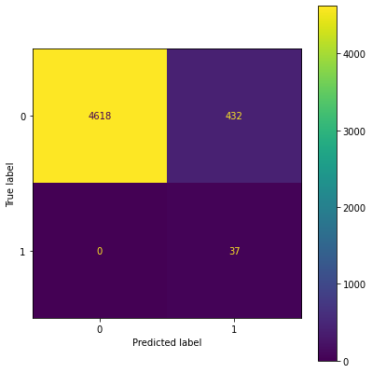
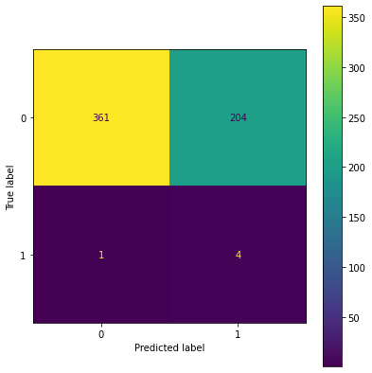
Logistic Regression: Resulting Data
Training Accuracy: 91.5%
Testing Accuracy: 64.0%
Notes:
Testing acc = actual performance -> pretty bad, wouldn’t want to use this in a real life situation

Slide 12
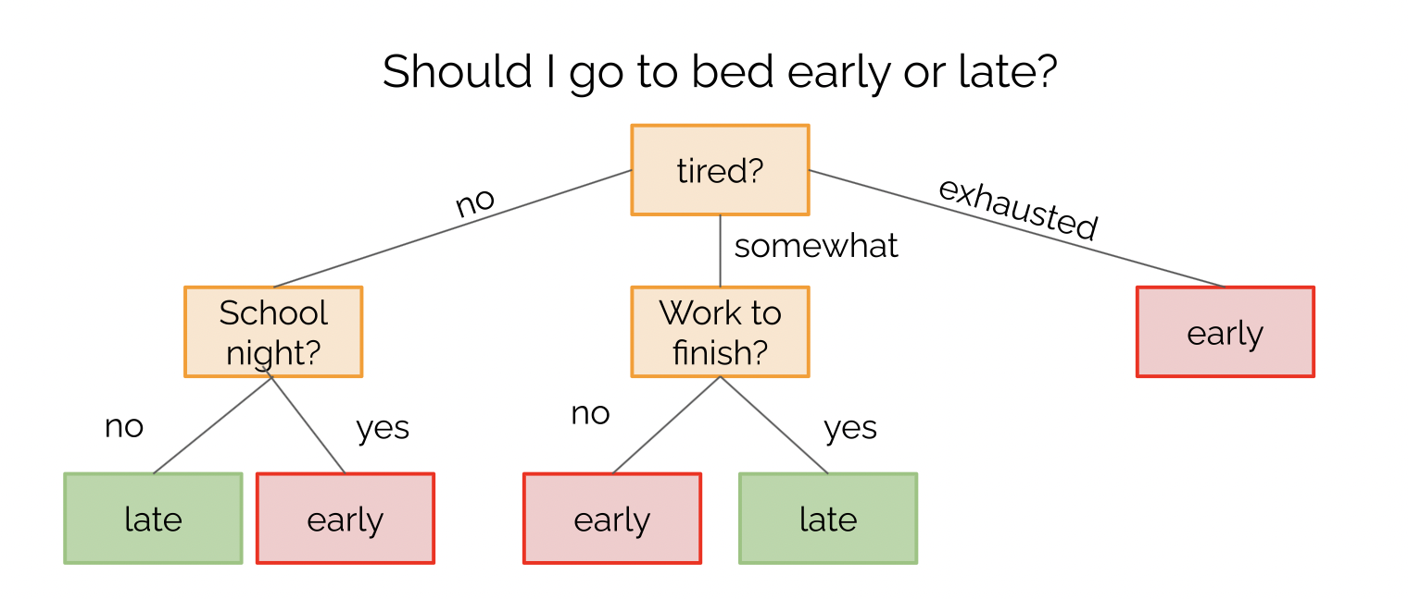
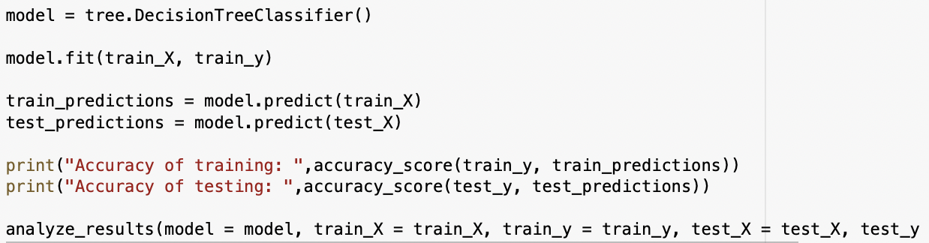
Decision trees:
Decision trees are an innate way to make classifications and regressions. Is aim is to create a model by learning rules inferred from the data features given.

Slide 13
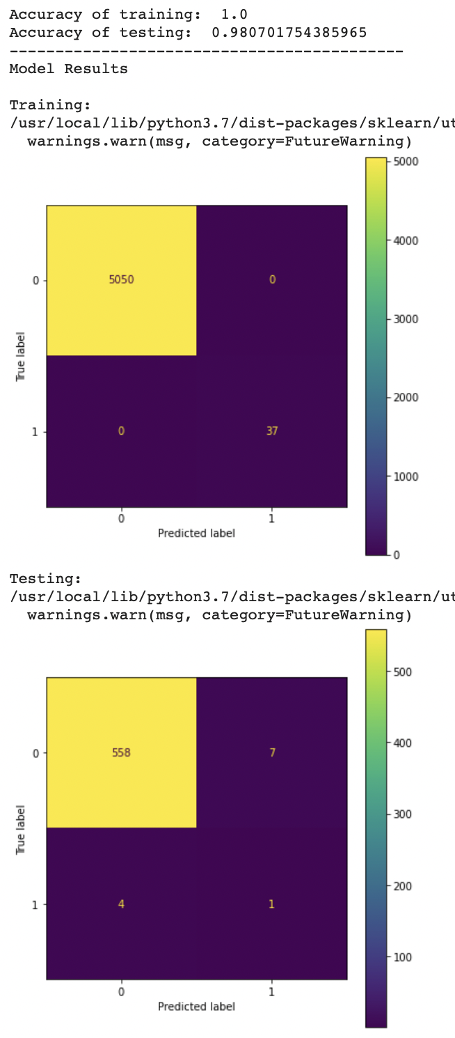
Decision Trees: Resulting Data
Training Accuracy: 100% Testing Accuracy: 98.1%

Slide 14
Decision trees: Code used
The model used is the decision tree classifier
Prints the accuracy of the training and testing data
Returns the resulting data in a confusion matrix

Slide 15
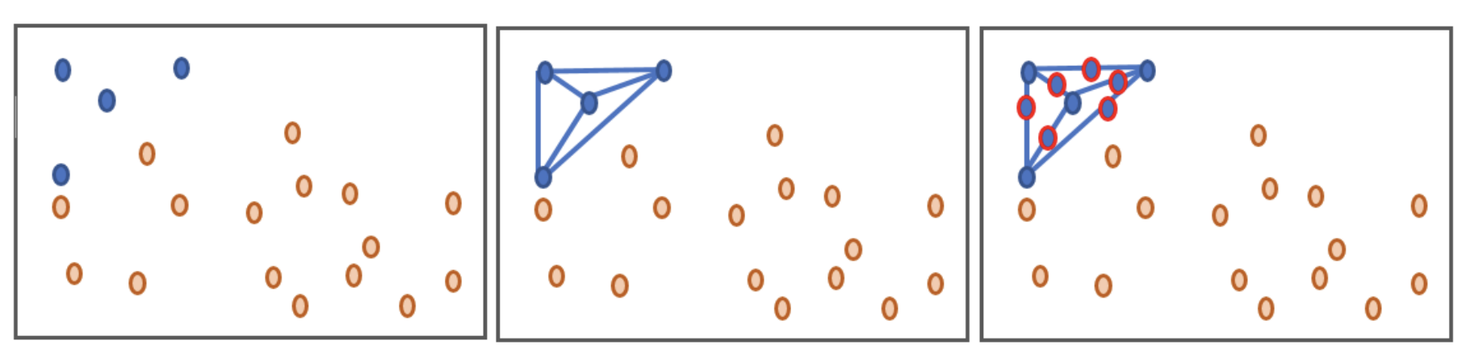
Augmented Data + KNN Classifier
In this scenario, we make use of a combination of the previously mentioned KNN Classifier with what we call augmented data. This data is simply an improvement of the dataset so that there’s a better ratio of exoplanets to non-exoplanets, and this could enable the machine to make better exoplanet predictions.
Notes:
Data augmentation is basically a way of improving our data so that we get a better exoplanet to non-exoplanet ratio so that the machine can make better predictions (for exoplanets)

Slide 16
Normal Data vs Augmented Data
Type of Data | Normal Data (Training) | Augmented Data (Training)
Amount of Stars | 5087 | 7070
% of Exoplanets in Dataset | 0.73% | 50%
Notes:
Data here shows much higher exoplanet % and larger dataset size

Slide 17
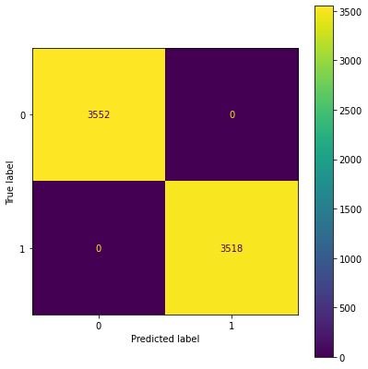
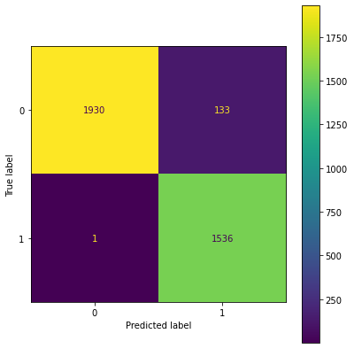
Augmented Data + KNN Classifier: Resulting Data
Training Accuracy: 100%
Testing Accuracy: 96.3%
Notes:
100% training accuracy, but what is interesting lies in the testing confusion matrix. The machine nearly didn’t miss a single exoplanet, although overall accuracy dropped.

Slide 18
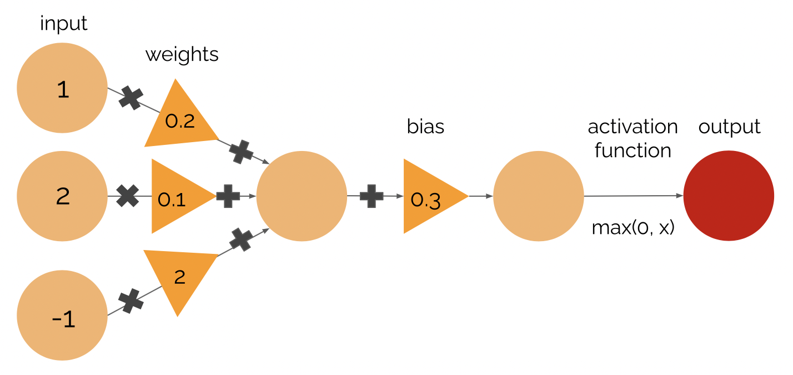
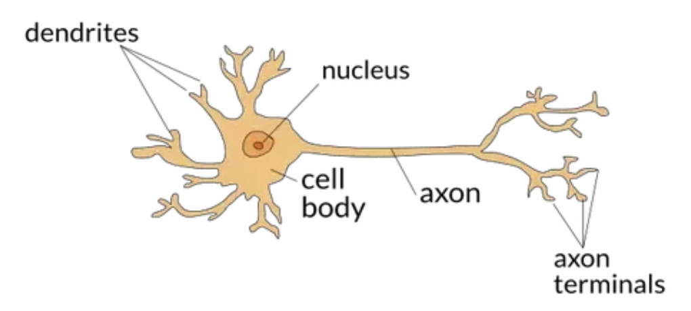
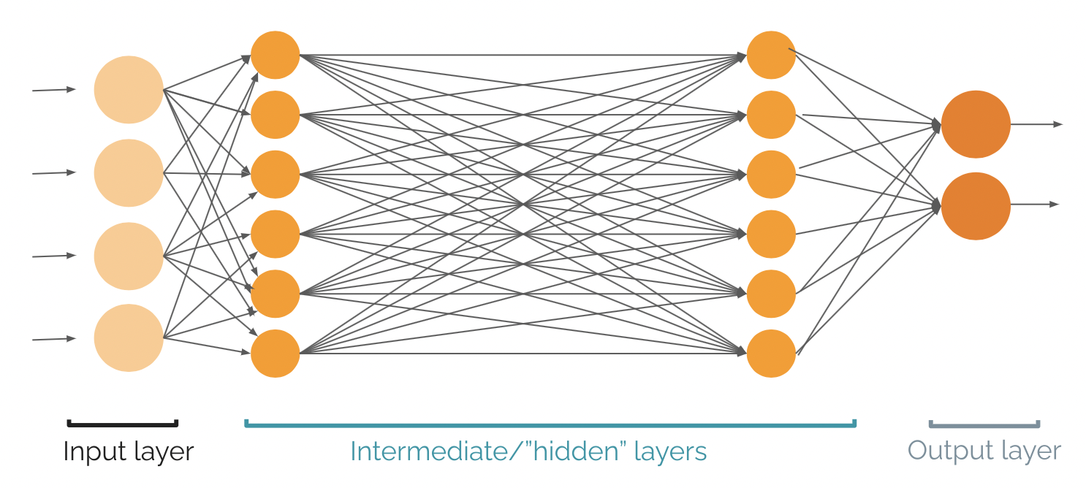
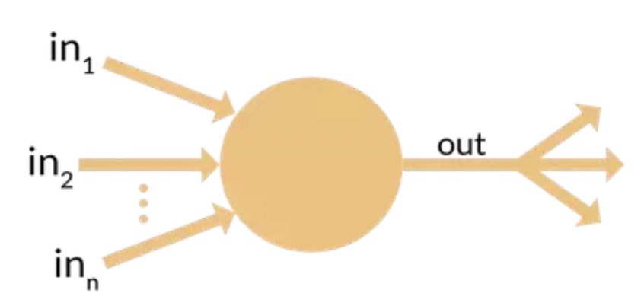
Neural Networks
Neural networks are used for more complex problems such as computer vision.
Biological neuron
Basic neuron diagram used in computing

Slide 19
Neural Networks: Resulting Data
 | Hidden layer size | Augmented training accuracy | Augmented testing accuracy
0. | (76)
1. | (10, 10)
2. | (4, 17)
3. | (2, 4, 6, 8, 10)
4. | (4, 17, 60)
5. | (1, 1, 1, 1, 1, 1, 1, 1)
6. | (1, 1, 2, 3, 5, 8, 13, 21, 34)

Slide 20
Neural Networks: Resulting Data
 | Hidden layer size | Augmented training accuracy | Augmented testing accuracy
0. | (76) | 99.89% | 99.58%
1. | (10, 10) | 99.45% | 99.08%
2. | (4, 17) | 99.93% | 99.33%
3. | (2, 4, 6, 8, 10) | 99.89% | 99.61%
4. | (4, 17, 60) | 100.00% | 99.50%
5. | (1, 1, 1, 1, 1, 1, 1, 1) | 50.13% | 57.53%
6. | (1, 1, 2, 3, 5, 8, 13, 21, 34) | 49.87% | 42.47%
Most accurate testing data
Least accurate testing data

Slide 21
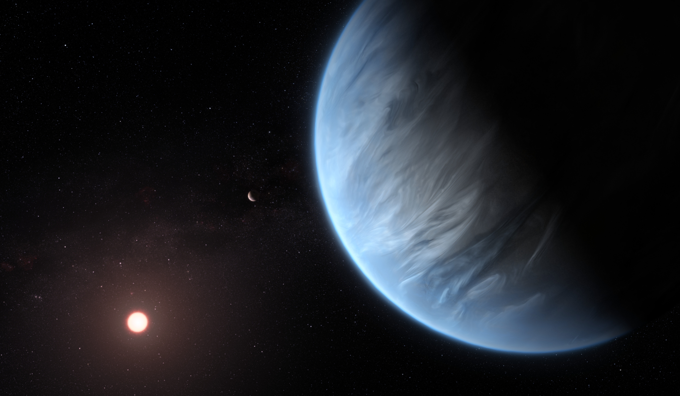
Thank you for watching!
Exoplanets are hard to find, but with Machine Learning techniques we can find many more exoplanets, maybe even ones that have liquid water or life.
And a special thanks to our instructor, Katherine

